Slide 1
Choose columns for the dashboard axis
*
Vertical axis- column 1:
(Options)
Requests for this screen:
1. Click on any of the 3 first rectangular will open a window with all the excel file headers
2. This screen must be displayed in this way
3. Every selection with red asterisk, must be selected by the user. if not, when you click the “show dashboard” button it will print error “fill all the required fields”
4. The text box is not a required field. in the beginning, it will show the text I wrote when the user starts to write in, it automatically clean and present the user input in the text box, and in black color.
Vertical axis- column 2:
(Options)
*
Horizontal axis- column:
(Options)
Write here the title for the dashboards
Show dashboard

Slide 2
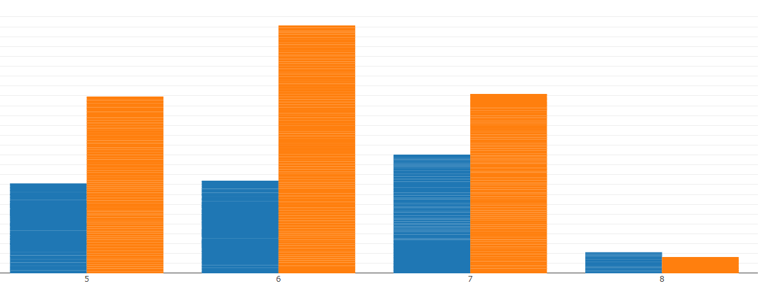
Filters:
Dashboard type:
(The given title name)
(Name of filter 2)
(Name of filter 3)
(Given name of the chosen vertical axis 1 and 2)
(Name of filter 4)
(Name of filter n)
(Given name of the chosen horizontal axis)
Requests for this screen:
The filters should be organized and display by their filters amount, min-0, max-8
Every filter should choose multiple options, no selected option in 1 filter will not show anything, until the user selected in any filter at least one option
If there is a column of dates in the excel file, it should present a filter of date range

